Slide 1
Global Economic And Demographic Trends Analysis
Presented By:
NAVYATHASRI R
DADS

Slide 2
Project Objectives :
Analyze global population, GDP, literacy, and health indicators
Identify country-wise and region-wise trends
Perform descriptive statistical analysis
Apply DAX for advanced calculations
Build an interactive power BI dashboard for insights

Slide 3
Project Overview :
Economic growth trends across countries
Population changes over time
Relationship between literacy levels and GDP
Country-wise comparative insights
The analysis helps identify how education and population influence economic development.

Slide 4
Data Cleaning:
Removing duplicate country codes
Handling missing and null values
Data type corrections
Unpivoting year columns into usable format
Standardizing country names and codes

Slide 5
DAX Calculations:
Key Measures Created Using DAX
Total Population
Average GDP per Capita
Average Literacy Rate
Average Infant Mortality Rate
Population Growth Trend
GDP Aggregation by Region

Slide 6



KPI’s and Slicers:
Key KPIs (Top Cards)
Total Population
Average GDP per Capita
Average Infant Mortality
Total Population
Interactive Features
Year
Country
Region

Slide 7
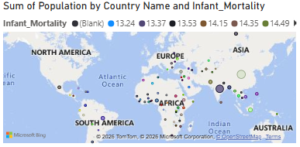
Population Density by Region
South Asia and East Asia & Pacific have the highest population concentration.
Europe & Central Asia has moderate population density spread across many countries.
Sub-Saharan Africa shows uneven population distribution across a wide area.
North America has low population density despite its large land area.
Latin America & Caribbean has moderate population density in specific regions.
Middle East & North Africa has population clusters in limited habitable areas.

Slide 8
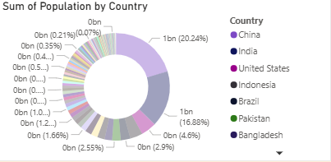
GDP Contribution by Region
North America and Europe & Central Asia contribute a large share of global GDP despite smaller populations.
East Asia & Pacific has a strong GDP contribution due to rapid industrial growth.
South Asia has a low GDP share compared to its large population, showing lower GDP per capita.
Latin America & Caribbean contributes a moderate share of global GDP.
Middle East & North Africa GDP is mainly driven by natural resources.
Sub-Saharan Africa has the lowest GDP contribution, indicating development challenges.

Slide 9
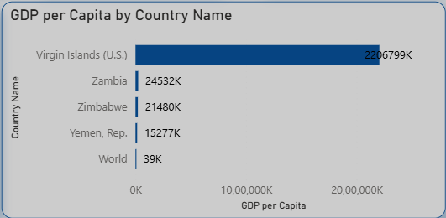
GDP per Capita By Country
There is a huge disparity in GDP per capita across countries, showing strong global economic inequality.
U.S ranks highest, indicating very high income levels compared to other countries.
Zambia, Zimbabwe, and Yemen fall at the lower end, reflecting weaker economic performance and lower living standards.
The world average GDP per capita is much lower than top economies, masking country-level differences.
GDP per capita is a better measure of individual prosperity than total GDP when comparing countries.

Slide 10
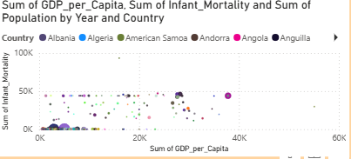
Population Trends Over Time
The global population shows a steady and continuous increase from 1960 to around 2015, indicating sustained long-term growth.
Growth accelerates after the 1980s, reflecting improvements in healthcare, sanitation, and living standards worldwide.
Asia-related regions contribute the largest share to total population growth, dominating the overall trend.
Africa (Sub-Saharan Africa) shows a noticeably faster growth rate in later years, highlighting rising demographic pressure.
Europe’s growth remains relatively slow, suggesting aging populations and lower birth rates compared to other regions.

Slide 11
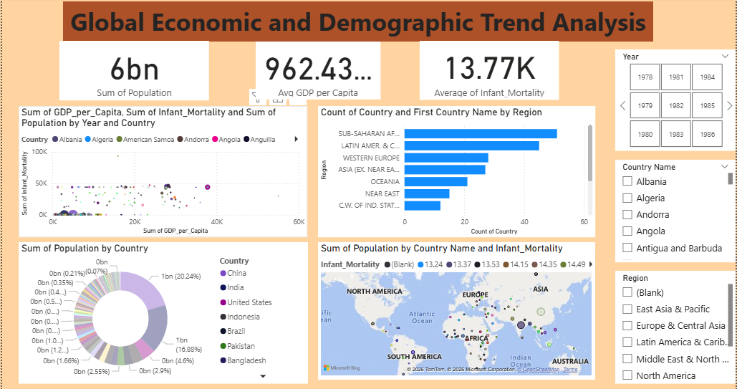

Slide 12
Thank You

